Slide 1
Module No 8
UiPath Advance Features(Code/API/Databases)

Slide 2
Learning Objectives
Injecting code stage
Run different types of scripts such as Python,powershell,VB.net.
Integration with different databases

Slide 3
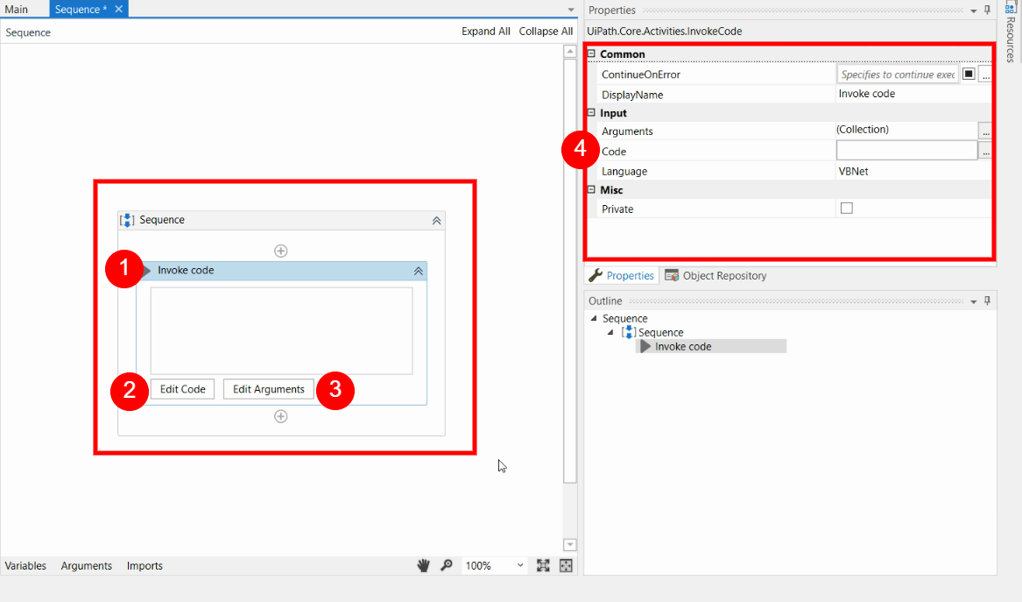
UiPath Invoke Code
UiPath.Core.Activities.InvokeCode invokes VB.NET or C# code, optionally passing it a list of input arguments. This activity can also return out arguments to the caller workflow.
Properties
Arguments - The parameters that can be passed to the code that is invoked.
Code - The code that is to be invoked. This field supports only strings and String variables.
Language - A drop-down menu that specifies what language the invoked code is written in. The available options are VBNet and CSharp.

Slide 4
UiPath Invoke Code Demo
Trainer Will Demo Sample .NET
Code Invoked using UiPath

Slide 5
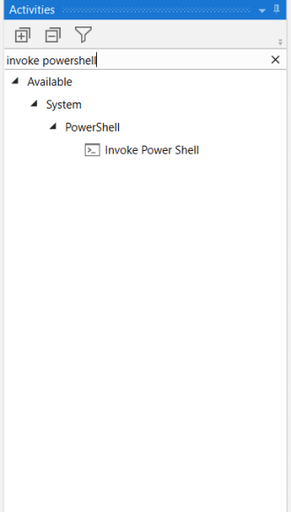
PowerShell UiPath Integration
PowerShell is a shell framework developed by Microsoft for administrative tasks and automation of repetitive jobs. It provides similar functionality to Command Prompt (cmd) but has more functions in it that makes it to be more powerful.
A common example is AD Group Management, You should be able to provide UiPath forms to attendant users to select the options and submit it and then trigger the PowerShell to perform required actions…
Why PowerShell UiPath Integration?
Many Admin stuff which are currently done by the your IT Admin can be automated using the PowerShell scripts and it can be further enhanced if you wish to integrate the flow with UiPath RPA tool.
To invoke the PowerShell Script in UiPath you need to use invoke PowerShell activity in UiPath which is coming under UiPath.System.Activities Package
This is already available, So you don’t need to install any additional packages.

Slide 6
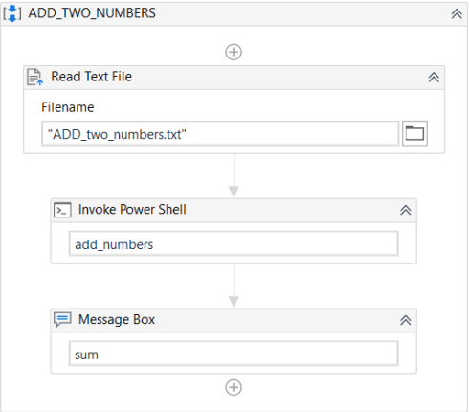
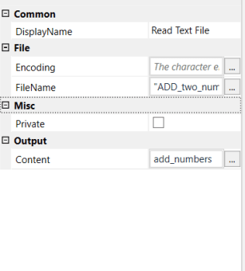
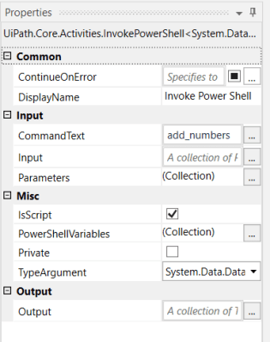
Steps to Use PowerShell script in UiPath
Step 1: Drag the Read text file activity in your workflow window and set the following properties.
Step 3: Drag the message box activity and provide text to be displayed as sum variable
Step 2: Drag the Invoke Power Shell in your workflow window and set the following properties.
CommandText : Pass the PowerShell command that is to be executed. In our example, the PowerShell Script is stored in add_numbers.
IsScript : This option should be unchecked since we are using a PowerShell script.
PowerShellVariables : Add the input and output variables which need to be transferred to scripts for the processing. In our example, num1, num2, result are parameters in the PowerShell script.
More References - https://rpabotsworld.com/powershell-uipath-integration/

Slide 7
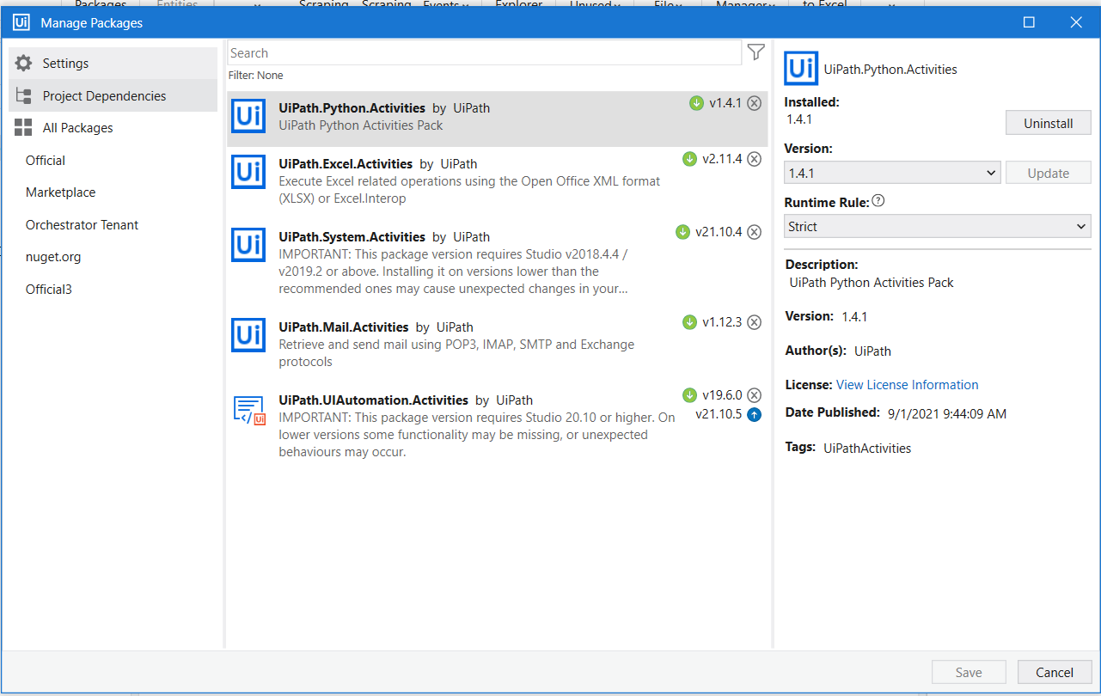
Python Integration With UiPath
Python language needs no introduction today and with the growing no of machine learning & artificial intelligence use cases in RPA industry its is obvious choice to integrate your workflow with python.
Due to huge no of the libraries(modules and packages) available in python its first choice of language to perform such task…One such example is Pandas – an amazing library which provides flexible and high-performance data structure manipulation and analysis tools.
Pre-Requisite
Supported Python Interpreter (Not all Interpreter are being supported by UiPath)
UiPath Python Activities Pack Must be added as Dependencies
Notepad ++ / Pycharm (Or any Python Editor )- Optional to test script outside Uipath

Slide 8
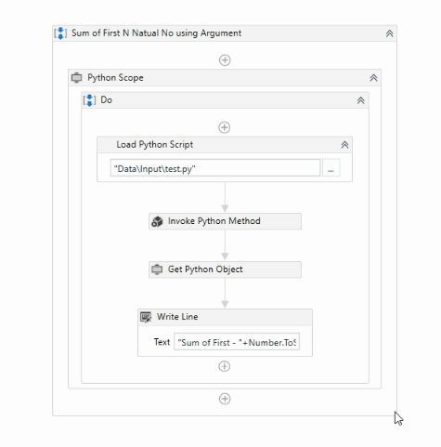
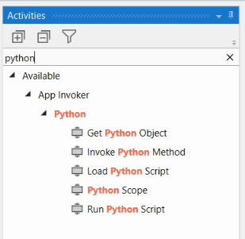
Python Integration With UiPath
The UiPath.Python.Activities contain the following activities:
Get Python Object – Retrieves the .NET type used in a specified Python script.
Python Scope – A container which provides scope for Python activities.
Invoke Python Method – Helps you run a specified method from a Python script directly in a workflow.
Load Python Script – Converts your Python code to a PythonObject variable.
Run Python Script – Enables you to execute Python code. You can input the code directly in the activity or provide a file path for it.

Slide 9
Python Integration With UiPath Steps
STEP 1- Drag Python Scope into your workflow window and set the following properties.
Python Path – This should be the location where your Python interpreter is installed, You should give the path at the Directory level. For my example its – C:\Users\XXXX\AppData\Local\Programs\Python\Python36 (Make sure to change accordingly)
Target – Did you install 64-bit variant or 32-bit variant of Python (In my case its x64)
Version – This is important as not all the python variants can be integrated with the Uipath so you should go with the available list only for example you won’t find python 3.7 + as of now
STEP 2- Drag Load Python Script
In this step, you need to either enter code in properties panel if small block or you should load external python file here(for my example its test.py kept inside folder)
You need to create a python Object as Result output which will be used for further processing(In my example I have created variable of python object type as sumsquare ), You can give any name
STEP 3- Drag Invoke Python Method
This is the most important step in python integration part –
Input Argument – You need to pass the argument to your python method here, So you need to make sure that arguments are matched with the program you have written. As of now, there is no support for named tuple and you need to provide your inputs as a dictionary as {arg1, arg2}. For my example, the input is {Number} as I have created Number variable to pass as Input Argument
Instance – You also need to recall your Python Instance Variable which you created in the previous step to be passed here. This is useful in case you need to invoke multiple python scripts so that the required instance of the object is referred. For my example python object is sumsquare
Name – Name is Name of the method inside your python’ program which needs to be called. Make sure to pass them inside ” ” as this is String – Name of the method to be invoked
Output – You need to store the result of the executed method into some python object which can be used for further processing. For my example, we have created a variable as SumPythonObject to store the result.
STEP 4 – Drag Get Python Object
In this step the result variable we have created in the previous step need to be converted into .NET type object so that they can be used into Uipath , Here we simple provide name of Variable we wish to convert into and Type of object.
PS- Some time you need to be careful here as all type of python objects cant be converted into .NET objects, You need to make sure types are compatible.
Once .NET object Variable is ready you can use with as usual to work in Uipath. For my example, SumUipathObject is the variable name which is converted from SumPythonObject variable.

Slide 10
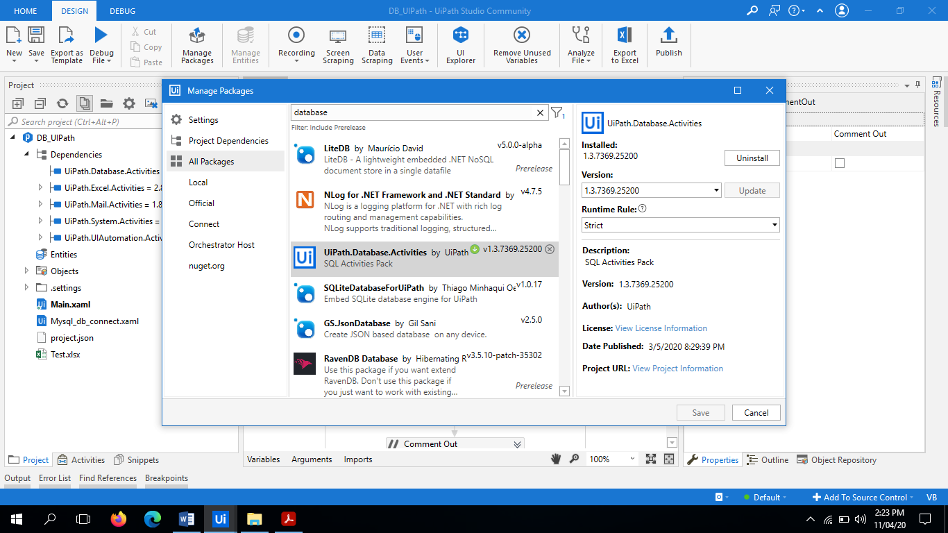
Database Integration With UiPath
Uipath Database pack enables the user to connect to a database and perform different action within it, such as executing queries, transactions, and non-queries.
There are different types of activities that are present under the Database package are as follows:
Connect
Disconnect
Execute Non Query
Execute Query
Insert
Start Transaction
Let’s discuss these activities one by one in detail.

Slide 11
Database Integration With UiPath
Connect: This activity requests a connection string to establish a database connection and a ProviderName. The connection string must contain a data source, a username and a password. This activity outputs a DatabaseConnection variable which you can use throughout further activities.
Disconnect: This activity closes a connection to a database.
Execute Non Query: This activity executes a non-query (Update, Insert, and Delete, etc.) statements that do not return any result sets. This method returns the number of rows affected by either any of the non-query statements.
Execute Query: Executes the query on a database and returns the query result in the datatable. SQL command to be executed to get the results.
Insert: This activity inserts a data table records into an existing database table. For this you need to provide the table name and the data table variable that will be inserted into table in the properties panel of Insert activity.
Start Transaction: This activity is used to connect to a database and can include any database related activities in it. It gives us the output with a database connection variable which can be passed as input to other database activities as input for connection string. If UseTransaction is set true, the contained operations are executed in a single transaction, and applied at the end if none of them failed. If UseTransaction is set to false, all operations are committed individually. When this activity ends, the connection to the database is closed.

Slide 12
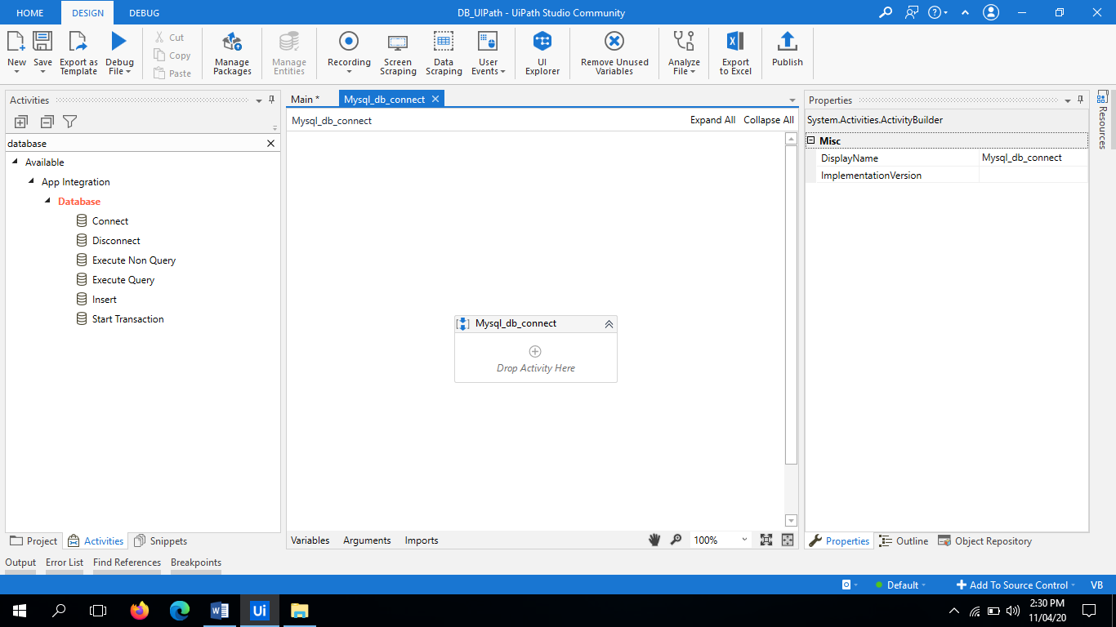
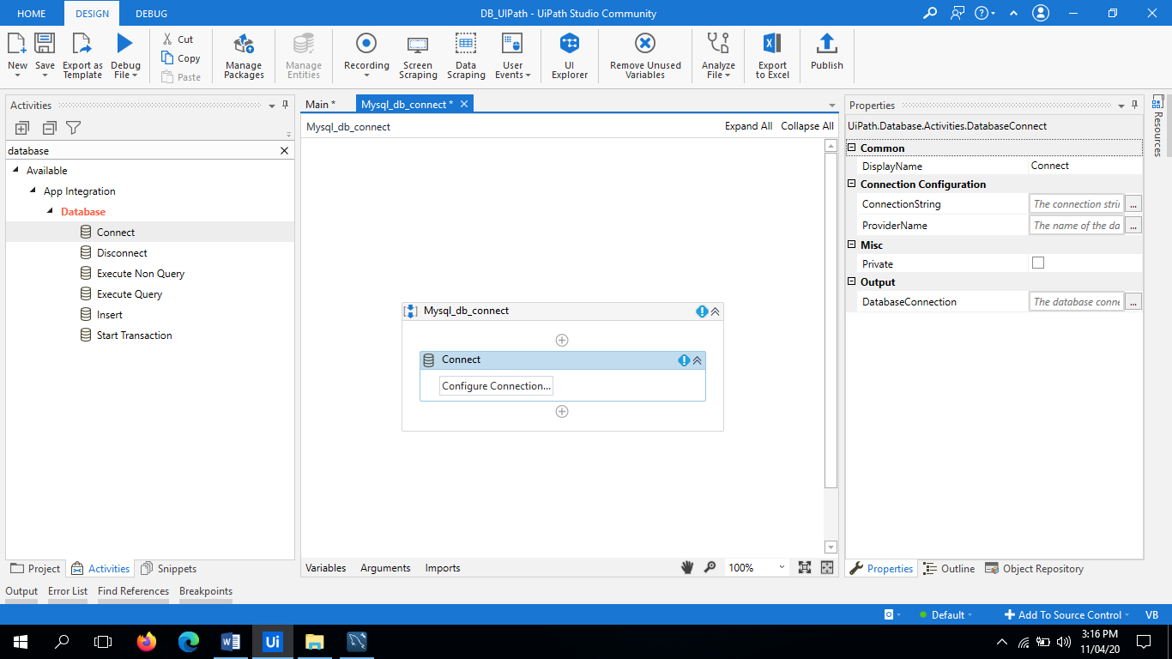
Database Steps With UiPath
Step 1 - Install the database package from manage packages.
Step 2- Now In activities panel search “Database”, you will see various database activities as shown in figure.
Step 3- Now go to UiPath and Drag the “Connect” activity in the sequence.
Connect: This activity requests a connection string to establish a database connection and a ProviderName. The connection string must contain a data source, a username and a password. This activity outputs a DatabaseConnection variable which you can use throughout further activities.
For Example-
Server=127.0.0.1;port=3306;database=databasename ;uid=root;password=*****;

Slide 13
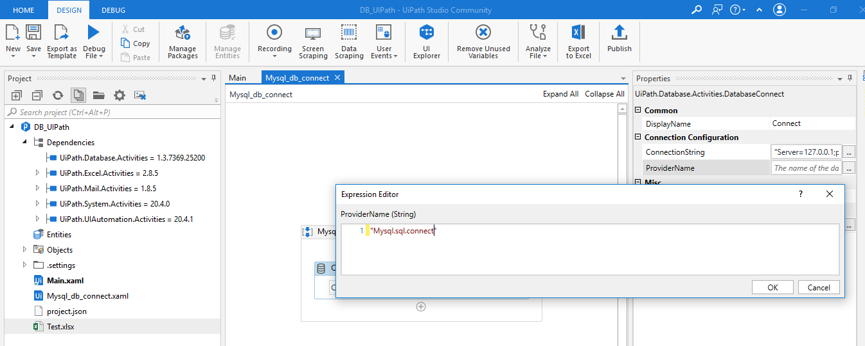
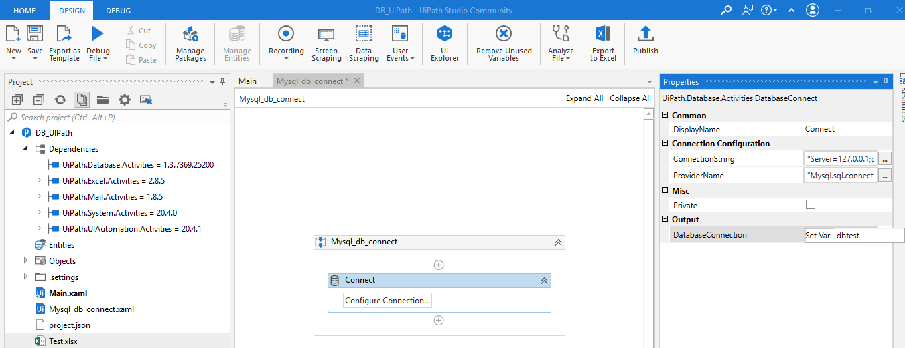
Database Steps With UiPath
Step 4- Now provide the provider name as “Mysql.sql.connect" under Properties panel.
Step 5- Now provide the output variable of the connection so that the same connection properties can be used in other database activities.
DatabaseConnection = dbtest

Slide 14

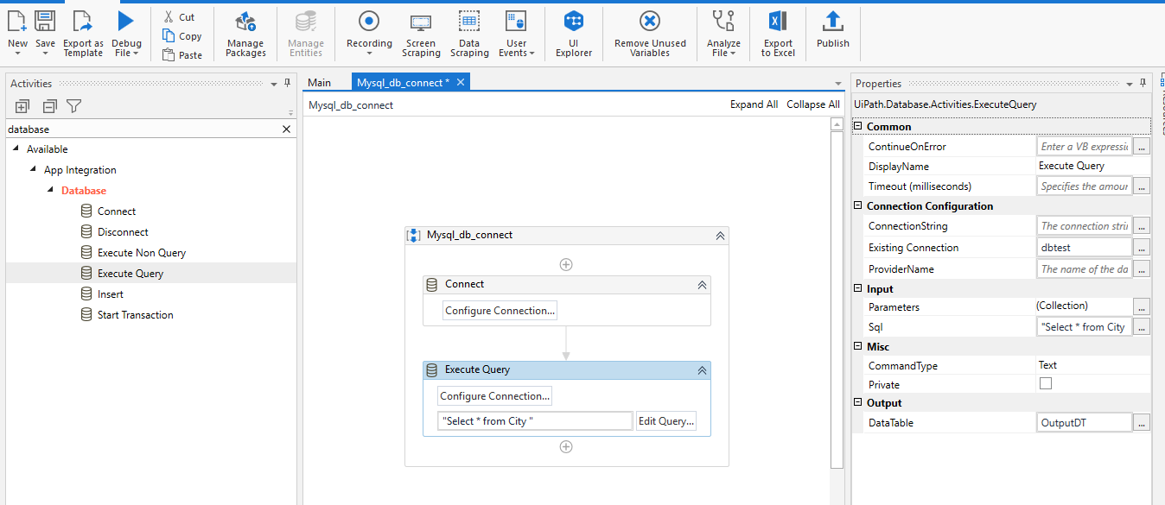
Database Steps With UiPath
Step 6- Now if you see the connection established successfully and warning is not visible in connect activity.
Step 7- Now Drag the activity “Execute Query” in the sequence.
Execute Query: This activity executes a query on a database and returns the result of the query in the datatable.
Package: Uipath.Database.Activities.ExecuteQuery
In this activity, three important properties always should be in mind:
1. Existing Connection: Use the output of the connect activity to use its connection properties in execute query.
2. SQL: Write the SQL query as a string.
3. Datatable: Store the result in the datatable variable. (Create the datatable variable as “OutputDT”

Slide 15
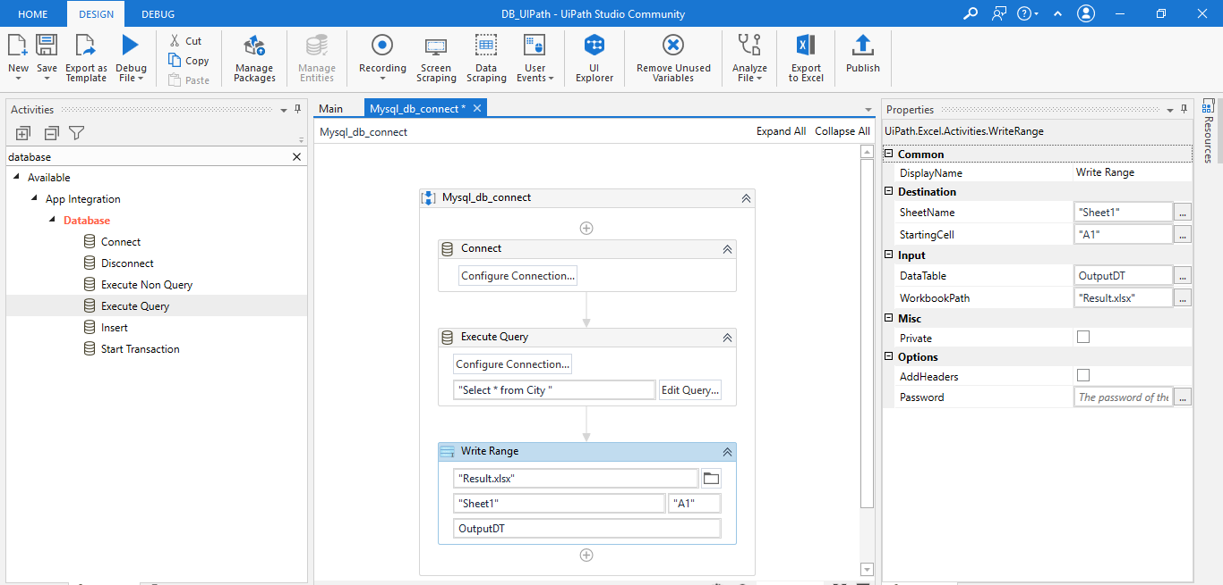
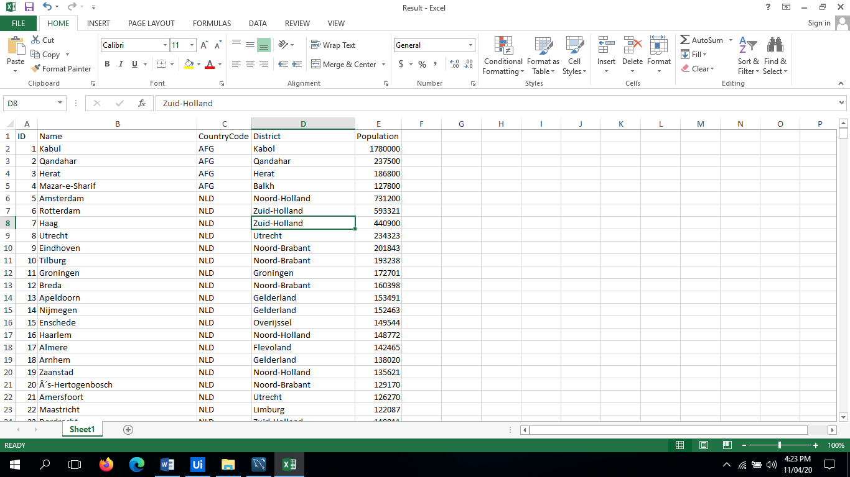
Database Steps With UiPath
Step 8- Now you are all set to execute the query from the UiPath. Run the file and see the results.
Execution successful.
Result of data table that we have write in the workbook as shown below.
In this way you can write the different types of queries (like Select, Update, Delete, Drop, Truncate, etc.) And get the results.

Slide 16
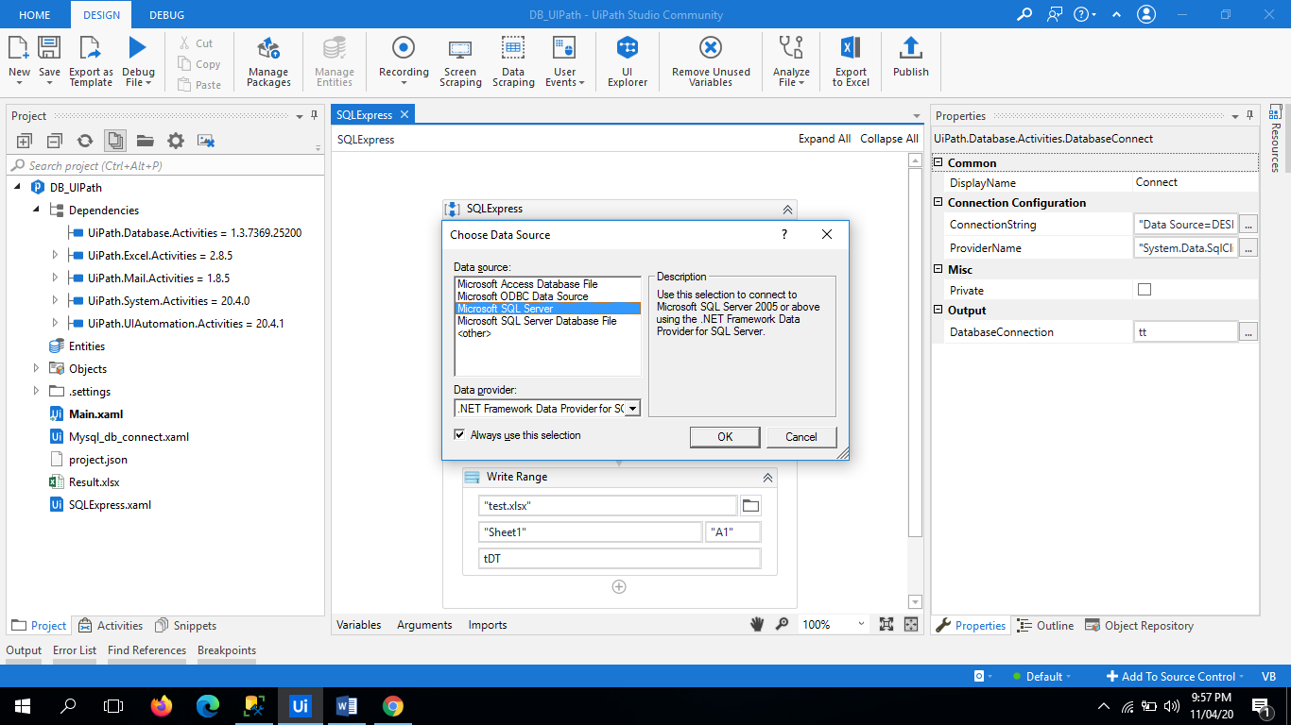
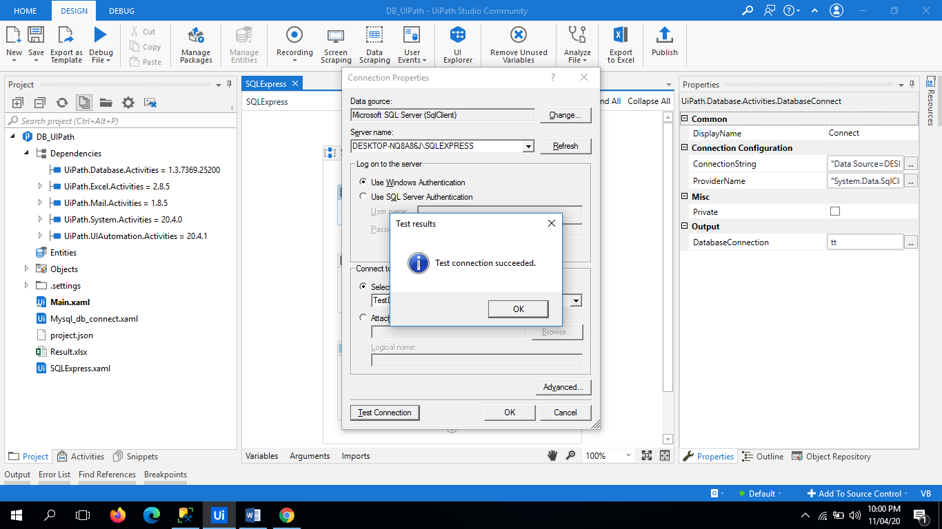
Database Steps With UiPath
For SQL Server Express Connections :
Select the “Microsoft SQL Server” Data source and click OK, On clicking the Connection Properties window opens where you have to select the Server Name (Automatically appears in the list), and Database Name (automatically appears in the drop down).
Note: If you have your authentication credentials then select the “Use SQL Server Authentication” and provide the username and password for the same.
Connection string is appear as :
"Data Source=DESKTOP-NQ8A86J\SQLEXPRESS;Initial Catalog=TestDB;Integrated Security=True"

